Slide 1
S2-23_AIMLCZG515: Distributed Machine Learning
Dr. Chandra Sekhar V
Chandrasekhar.v@pilani.bits-pilani.ac.in

Slide 2
Session 1
Date – 25th May 2024
Time – 1:40 PM to 3:40 PM
These slides are prepared by the instructor, with grateful acknowledgement of many others who made their course materials freely available online.

Slide 3
Session Content
Objective of course
Evaluation Plan
Course Overview

Slide 4
Objectives of the course
Introduce you to the foundational concepts of
Foundations of Parallel and Distributed Computing
Data Parallelism vs. Model Parallelism
Algorithm Scaling Examples
Distributed Deep Learning Algorithms
Federated Learning

Slide 5
Welcome to AIMLCZG515
This courses gives an overview of Distributed Machine Learning,
In particular, we will cover distributed machine learning algorithms.
• You will develop fundamental and practical skills in developing scaling machine learning algorithms.

Slide 6
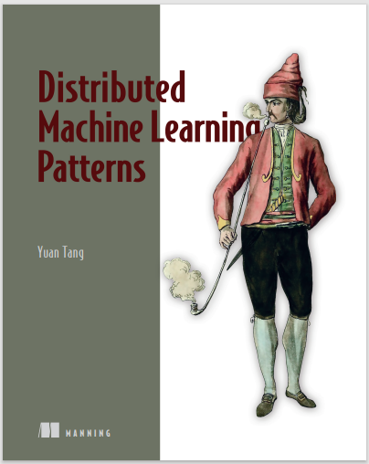
Text Book
Yuan Tang, Distributed Machine Learning patterns, Manning publications.
In addition, we will extensively use online materials (video lectures, blog posts, surveys, papers, etc.)

Slide 7
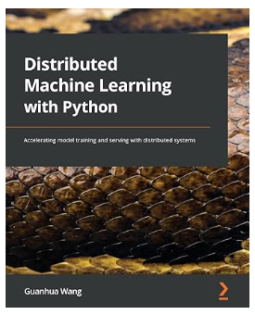
Text Book
Guanhua Wang, Distributed Machine Learning with python, Packt publications.
In addition, we will extensively use online materials (video lectures, blog posts, surveys, papers, etc.)

Slide 8
Evaluation Plan
Name | Type | Weight
2 Quiz, total of 2 scores | Online | 10%
Assignment-I | Take Home | 15%
Assignment-II | Take Home | 15%
Mid-Semester Test | Closed Book | 30%
Comprehensive Exam | Open Book | 30%
Please note there will be no change in submission dates for quiz and assignment

Slide 9

Pedagogy
Slides will be used to teach during the regular lectures
Lab demo and/or problem solving during the webinars
Students are responsible for studying and keeping up with the course material outside of class time.
Reading certain book chapters, papers or blogs, or
Watching some video lectures.

Slide 10
Lab Plan
Lab No. | Lab Objective
1 | Foundations of Parallel and Distributed Computing
2 | Data Parallelism vs. Model Parallelism
3 | Algorithm Scaling Examples
4 | Distributed Deep Learning Algorithms
5 | Federated Learning
Labs not graded
Webinars may be conducted for lab sessions
Labs will be conducted in Python

Slide 11
Course Topics

Slide 12
1. Foundations of Parallel and Distributed Computing 2. Data Parallelism vs. Model Parallelism 3. Algorithm Scaling Examples 4. Distributed Deep Learning Algorithms 5. Federated Learning
Course Topics

Slide 13
Distributed Machine Learning
Distributed machine learning is an advanced approach to machine learning (ML) that involves spreading computational tasks across multiple processing units, typically across a network of computers.
This method is particularly useful for handling large datasets, complex model architectures, and intensive computation tasks that are too challenging for a single computer to process efficiently.
Here’s a detailed explanation of distributed machine learning, touching on key aspects such as its need, architecture, techniques, applications, and inherent challenges.

Slide 14
Why Distributed Machine Learning?
1. The need for distributed machine learning arises from several modern-day requirements:
Large Datasets: With the explosion of data in fields like social media, healthcare, and finance, datasets have grown to a size (often terabytes or petabytes) that cannot be processed effectively on a single machine.
Complex Models: Advanced ML models, especially deep learning networks, have millions of parameters and require substantial computational resources that exceed the capacity of individual machines.
Speed and Efficiency: Distributed systems can significantly reduce the time needed for training and inference by parallelizing tasks and utilizing many machines simultaneously.

Slide 15
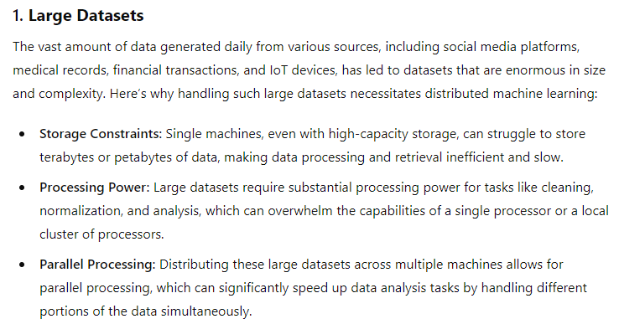
Why Distributed Machine Learning?

Slide 16
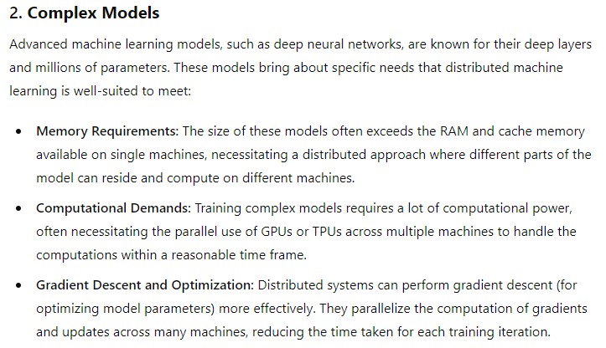
Generate Images

Slide 17
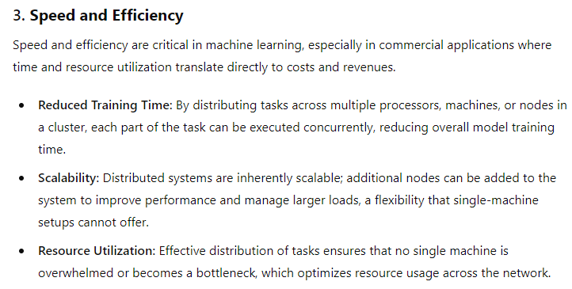
Generate Images

Slide 18
Large-scale machine learning
The scale of machine learning applications has become unprecedentedly large. Users
are demanding faster responses to meet real-life requirements, and machine learning
pipelines and model architectures are getting more complex.

Slide 19
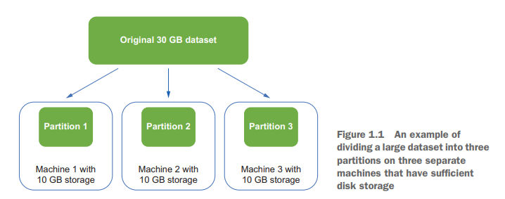
Data Partioning

Slide 20
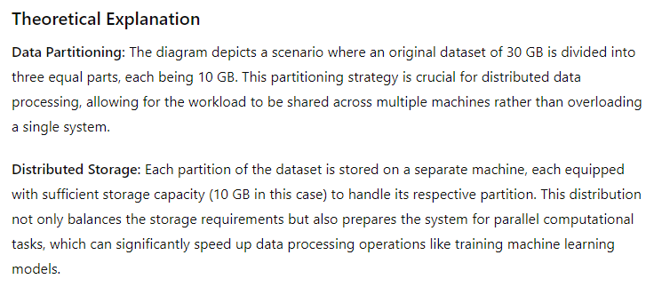
Generate Images

Slide 21
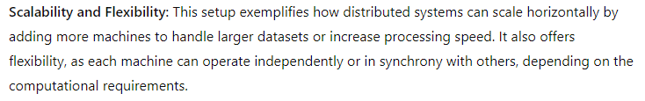
Generate Images

Slide 22
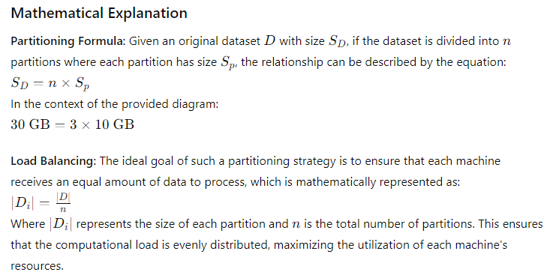
Generate Images

Slide 23
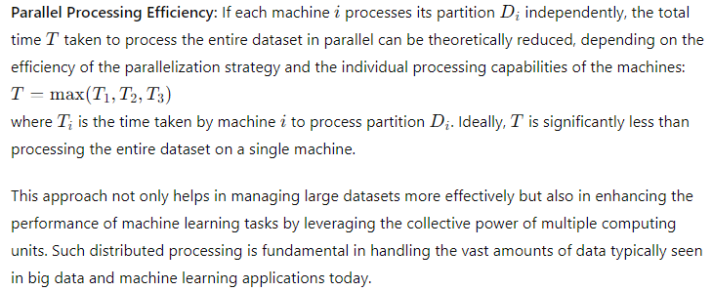
Generate Images

Slide 24
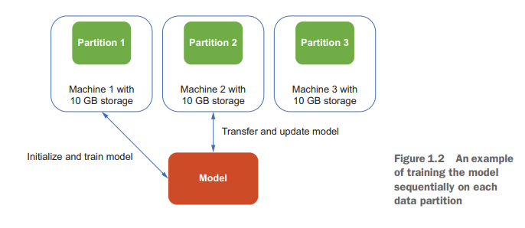
Generate Images

Slide 25
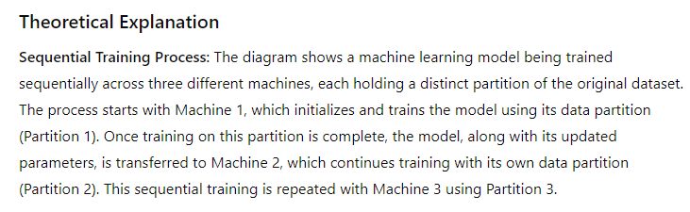
Generate Images

Slide 26
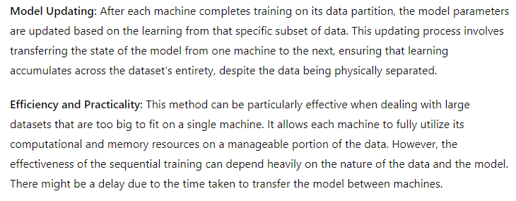
Generate Images

Slide 27
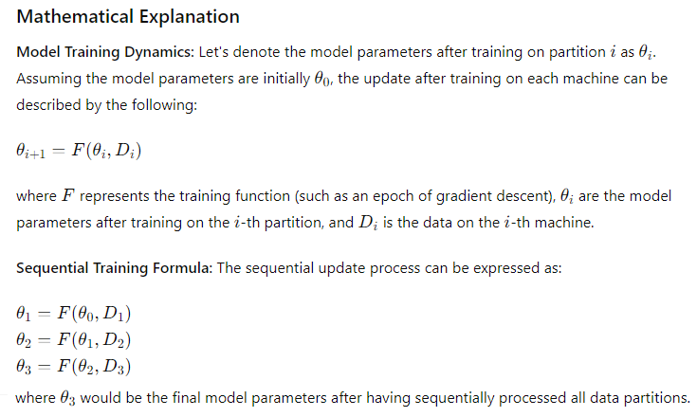
Generate Images

Slide 28
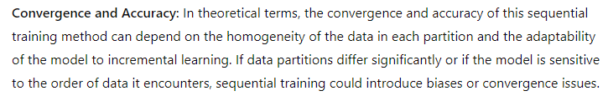
Generate Images

Slide 29
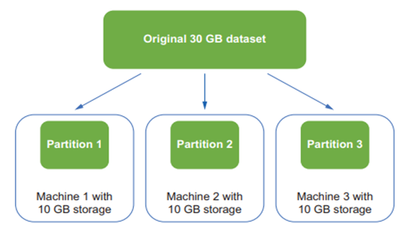
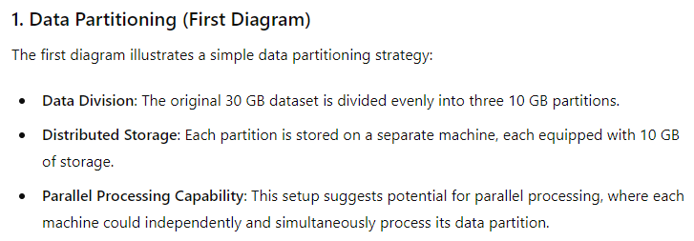
Generate Images

Slide 30
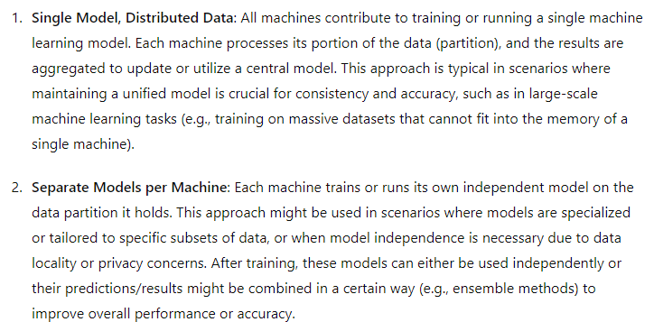
Generate Images

Slide 31
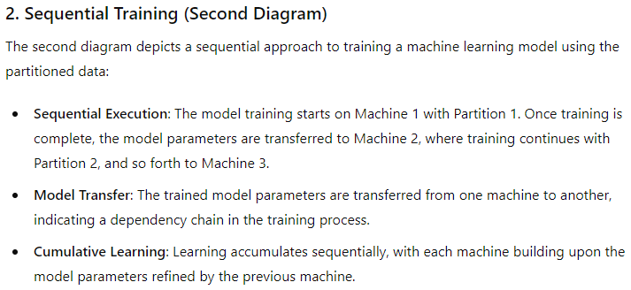
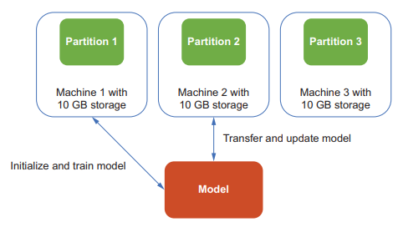
Generate Images

Slide 32
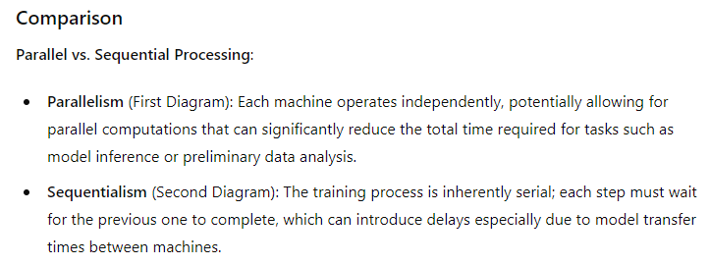
Generate Images

Slide 33
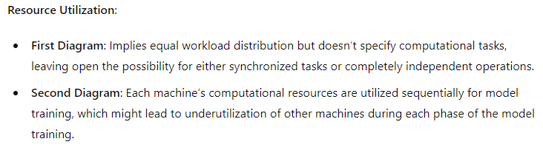
Generate Images

Slide 34
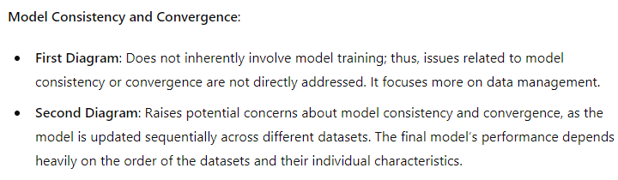
Generate Images

Slide 35
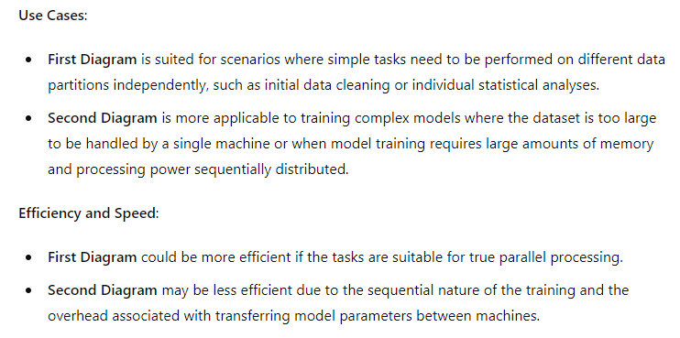
Generate Images

Slide 36
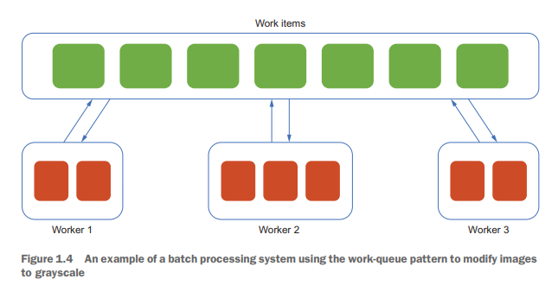
Batch Processing

Slide 37
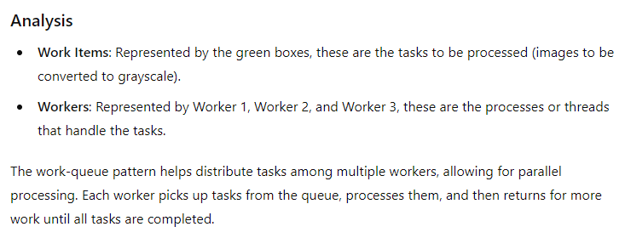
Batch Processing

Slide 38
Multiprocessing Theory
Multiprocessing is a method that allows the execution of multiple processes simultaneously, leveraging multiple CPU cores. This can significantly speed up computations, especially for CPU-bound tasks, by dividing the work among several processors.
Key Concepts
Process:
A process is an independent unit of execution that has its own memory space. Each process runs separately and does not share its memory with other processes.

Slide 39
Batch Processing
Thread:
A thread is the smallest unit of execution within a process. Multiple threads within the same process share the same memory space.
Concurrency vs. Parallelism:
Concurrency involves multiple tasks making progress, often by switching between them (context switching).
Parallelism involves multiple tasks running at the same time on different processors or cores.

Slide 40
Batch Processing
The work-queue pattern helps distribute tasks among multiple workers, allowing for parallel processing. Each worker picks up tasks from the queue, processes them, and then returns for more work until all tasks are completed.

Slide 41
Consistency Patterns in Distributed Systems
What exactly are distributed systems?
A distributed system, in simple terms, is a network of computers that work together as a unified unit. This unified unit ensures that users like us experience the internet and related services seamlessly.
In technical terms, a distributed system is a model in which components located on networked computers communicate and coordinate their actions only by passing messages.
These systems are everywhere - from the web services you use daily like Amazon and Google, to your banking app, and even the servers that host the multiplayer games.

Slide 42
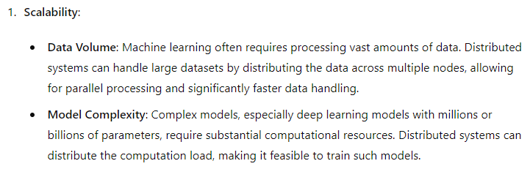
Why Distributed Systems Matter in machine learning

Slide 43
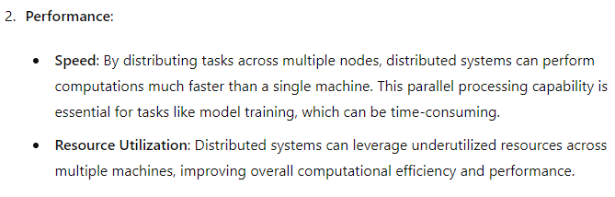
Consistency Patterns in Distributed Systems

Slide 44
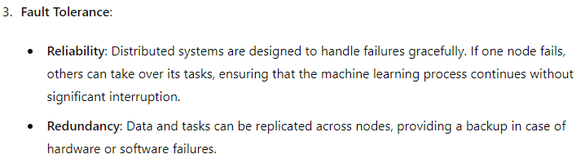
Consistency Patterns in Distributed Systems

Slide 45
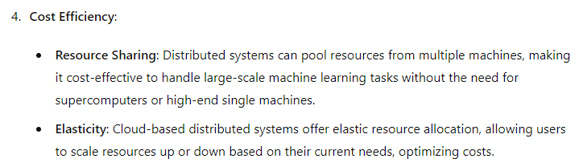
Consistency Patterns in Distributed Systems

Slide 46
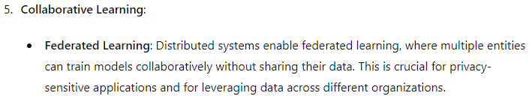
Consistency Patterns in Distributed Systems

Slide 47
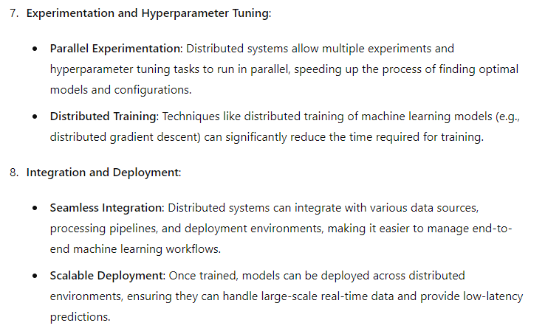
Consistency Patterns in Distributed Systems

Slide 48
Consistency Patterns in Distributed Systems
You see, consistency in a distributed system ensures that all users view the same data at the same time, irrespective of their location or the part of the system they are accessing.

Slide 49
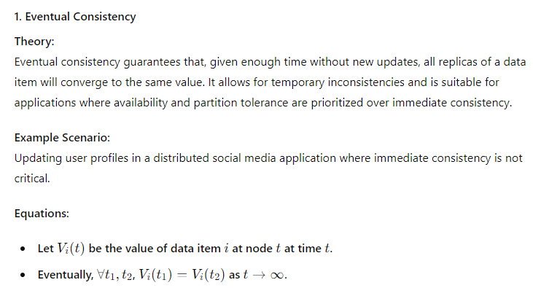
Consistency Patterns in Distributed Systems

Slide 50
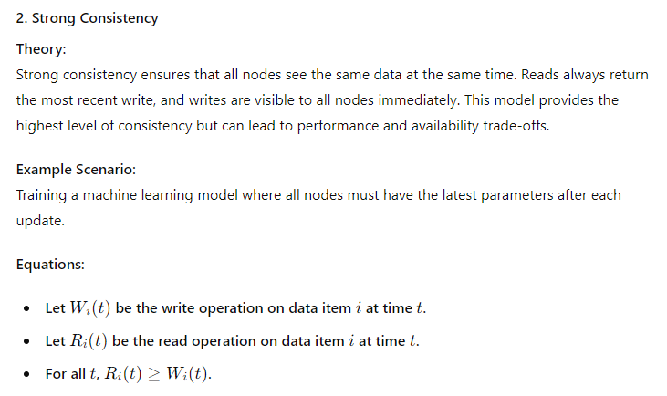
Consistency Patterns in Distributed Systems

Slide 51
Consistency Patterns in Distributed Systems

Slide 52
Consistency Patterns in Distributed Systems

Slide 53
Consistency Patterns in Distributed Systems

Slide 54
Consistency Patterns in Distributed Systems

